Slide 1
多 媒 體 系 統Multimedia System
張家瑋 博士
助理教授
國立臺中科技大學資訊工程系

Slide 2
Basic python3
基礎Python3

Slide 3
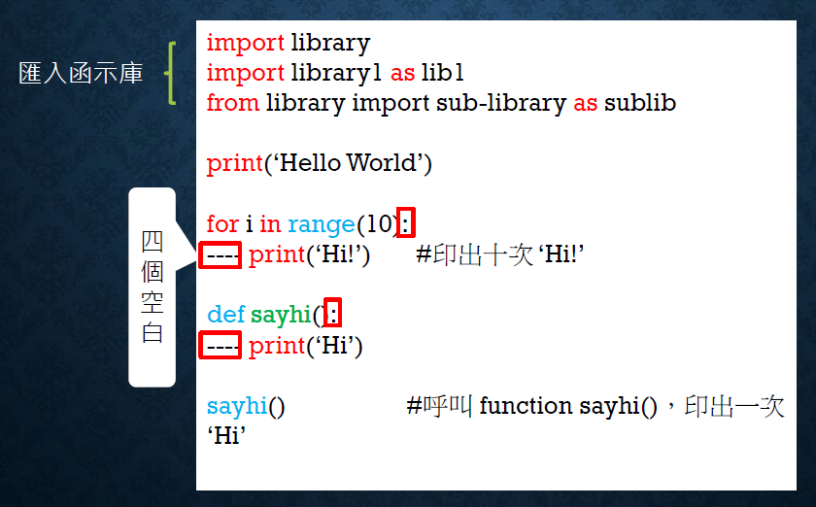
Code Structure

Slide 4
1
變數(Variables)
數字：int, float, long, complex
字串：string

Slide 5
常見的數值運算
(int, float, long, complex)
>>> 1+1
2
>>> 1-1
0
>>> 2*3
6
>>> 2**3
8
>>> 100/3
33.33333333333336
>>> 100//3 #求整數部份，無條件捨去
33
>>> 100%3 #求餘數
1

Slide 6
常見的字串運算與處理
>>> a = “Hello!”
>>> b = “World!”
>>> a+b
‘Hello!World!’
>>> a*2+b
‘Hello!Hello!World!’
>>>len(a) #字串長度
6
>>> s =“abcdefghij”
>>> s[3:5]
‘de’
>>> s[:5]
‘abcde’
>>> s[5:]
‘fghij’
>>> s[::2]
‘acegi’
>>> s[:]
‘abcdefghij’
>>> s =“abcdefghij”
>>> s[:-5]
‘abcde’
>>> s[-5:]
‘fghij’
>>> s[::-2]
‘jhfdb’

Slide 7
2
容器(Containers)
List
Array
Dictionary

Slide 8
列表 (List)
>>> a = [1, 2, 3]
>>> b = [4, 5]
>>> a.append(b)
>>> a
[1, 2, 3, [4, 5]]
-------------------
>>> a.extend(b)
>>> a
[1, 2, 3, 4, 5]

Slide 9
列表 (List)
>>> numbers = [0, 1, 2, 3, 4, 5, 6, 7, 8, 9]
>>> numbers[3:5]
[3, 4]
>>> numbers[5:]
[5, 6, 7, 8, 9]
>>> numbers[:5]
[0, 1, 2, 3, 4]
>>> numbers[::2]
[0, 2, 4, 6, 8]
>>> numbers[:]
[0, 1, 2, 3, 4, 5, 6, 7, 8, 9]

Slide 10
矩陣 (Array)
>>> l = [0, 1, 2, 3, 4, 5, 6, 7, 8, 9]
>>> import numpy as np
>>> a = np.asarray(l)
[0 1 2 3 4 5 6 7 8 9]
------------------------------
>>> import numpy as np
>>> a = np.arange(10)
[0 1 2 3 4 5 6 7 8 9]
>>> a[0]
0
>>> a[9]
9

Slide 11
矩陣 (Array)
因為Python沒有 array 型態，
必須透過上一頁的方法取得
numbers = [0 1 2 3 4 5 6 7 8 9]
---
>>> numbers[3:5]
[3 4]
>>> numbers[5:]
[5 6 7 8 9]
>>> numbers[:5]
[0 1 2 3 4]
>>> numbers[::2]
[0 2 4 6 8]
>>> numbers[:]
[0 1 2 3 4 5 6 7 8 9]

Slide 12
字典 (Dictionary)
>>> dictionary = { 1:‘one’, 2:‘two’, 3:‘three’}
--------------------------------------------------------------------
>>> square = {0: 0, 1: 1, 2: 4, 3: 9, 4: 16, 5: 25, 6: 36, 7: 49, 8: 64, 9: 81}
>>> square[5]
25
>>> square.keys()
dict_keys([0, 1, 2, 3, 4, 5, 6, 7, 8, 9])
>>> square.values()
dict_values([0, 1, 4, 9, 16, 25, 36, 49, 64, 81])

Slide 13
3
迴圈與條件式
for loop
if…else…

Slide 14
For 迴圈
>>> numbers = []
>>> for i in range(10):
numbers.append(i)
>>> numbers
[0, 1, 2, 3, 4, 5, 6, 7, 8, 9]
------------------------------
#簡寫
[i for i in range(10)]
[0, 1, 2, 3, 4, 5, 6, 7, 8, 9]
------------------------------
>>> square = {number: number**2 for number in range(10)}
>>> square
{0: 0, 1: 1, 2: 4, 3: 9, 4: 16, 5: 25, 6: 36, 7: 49, 8: 64, 9: 81}

Slide 15
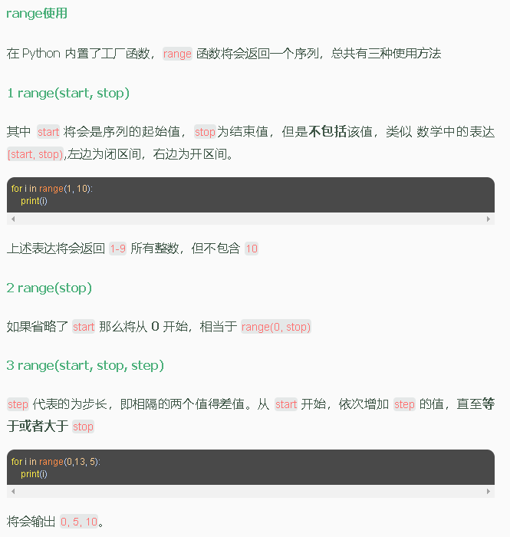
進階用法

Slide 16
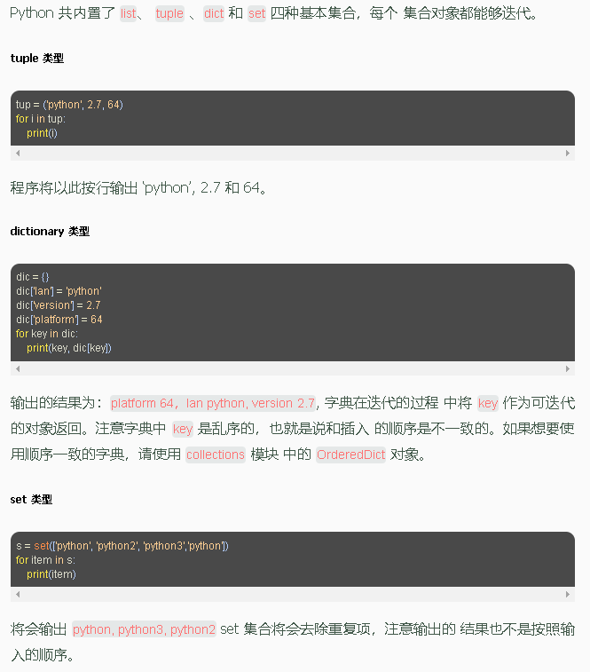
進階用法

Slide 17
進階用法

Slide 18
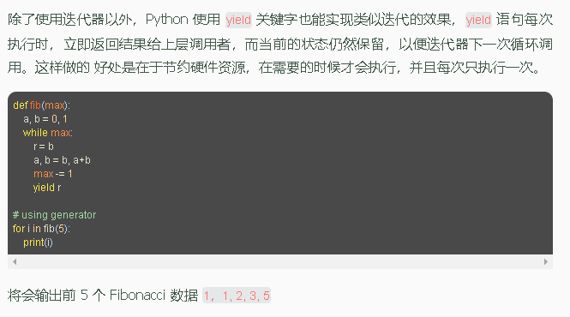
進階用法

Slide 19
if…else…
#簡寫
numbers = [ i for i in range(10) ]
[0, 1, 2, 3, 4, 5, 6, 7, 8, 9]
---------------------------------
for i in range(len(numbers)):
if( i == 0 ):
print(i, '是奇數也是偶數')
elif( i % 2 == 1 ):
print( i, '奇數' )
else:
print( i, '偶數' )
>>> numbers = []
>>> for i in range(10):
numbers.append(i)
>>> numbers
[0, 1, 2, 3, 4, 5, 6, 7, 8, 9]

Slide 20
4
函式與匿名函式
function
lambda

Slide 21
function
>>>def add(x, y):
>>> return x+y
---------------
>>>add(1, 1)
2
>>>add(1, -3)
-2
>>>def minus(x, y):
>>> return x-y
---------------
>>>minus(1, 1)
0
>>>minus(1, -3)
4

Slide 22
lambda
>>>add = lambda x, y : x + y
>>>add(1, -3)
-2
>>>newValue = lambda x : -x
>>>newValue(9)
-9

Slide 23
Print

Slide 24
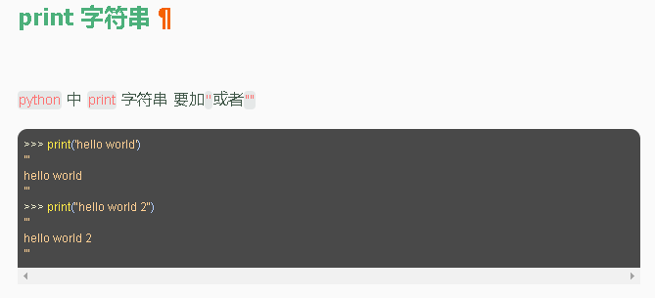
印出

Slide 25
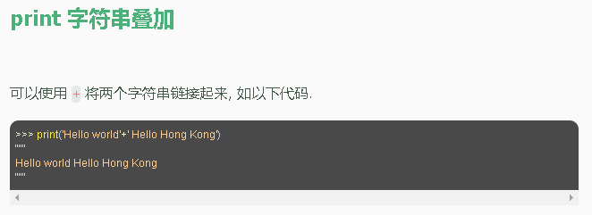
字串相加

Slide 26
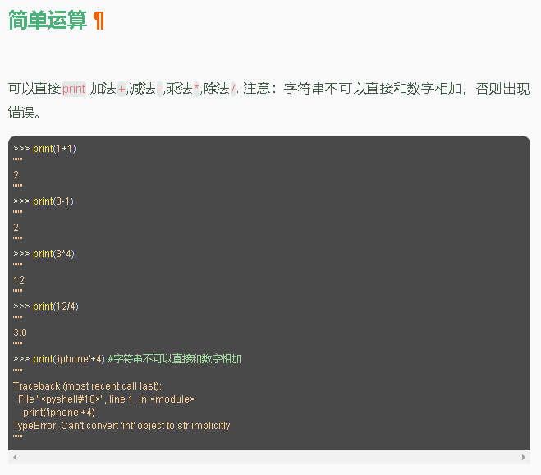
基本運算

Slide 27
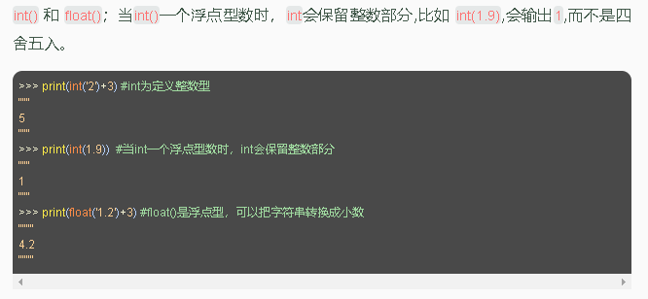
基本運算

Slide 28
寫檔讀檔

Slide 29
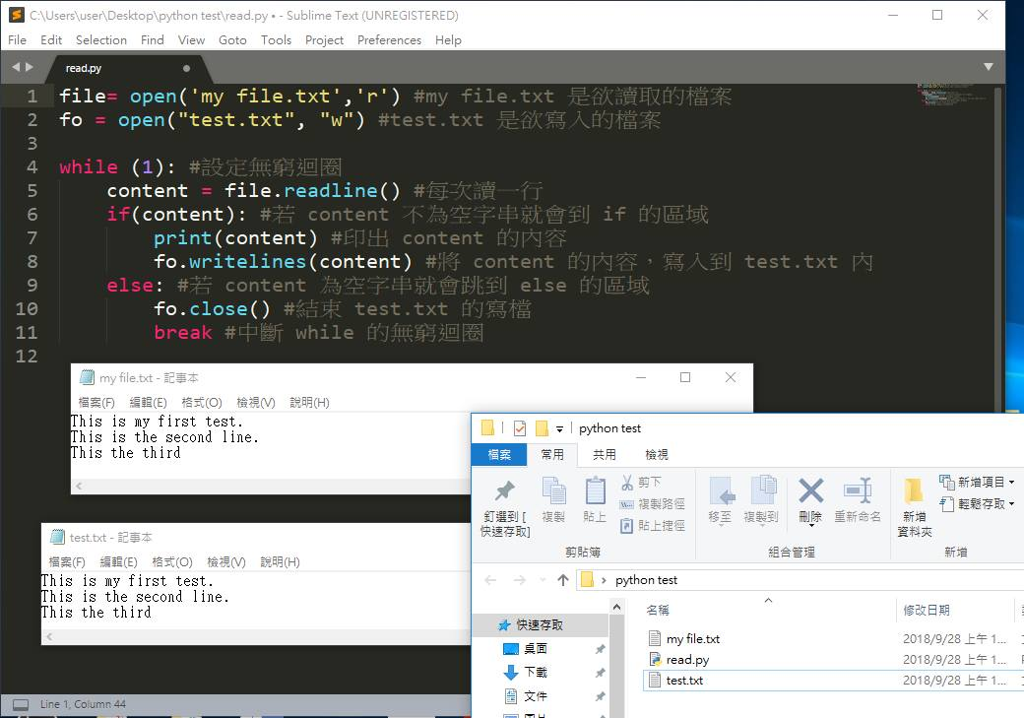
寫檔讀檔
Notes:
file = open(“my file.txt", “r", encoding='utf-8')
fo = open(“test.txt", "w", encoding='utf-8')

Slide 30
寫檔讀檔
file = open(“my file.txt", “r", encoding='utf-8')
fo = open(“test.txt", "w", encoding='utf-8')

Slide 31
Thank you

